Slide 1
Introduction to MGRIT
Alexander Magro

Slide 2
What is MGRIT?
Multigrid Reduction-in-Time method:
Parallel in time EXPLICIT scheme
Similar to Euler method, Runge-Kutta Methods etc.
Expansion of Parareal algorithm using multigrid methods
Yesterday: How to implement of MGRIT and Parareal
Today: Brief introduction to:
Multigrid Theory
Step by Step of Parareal
MGRIT

Slide 3
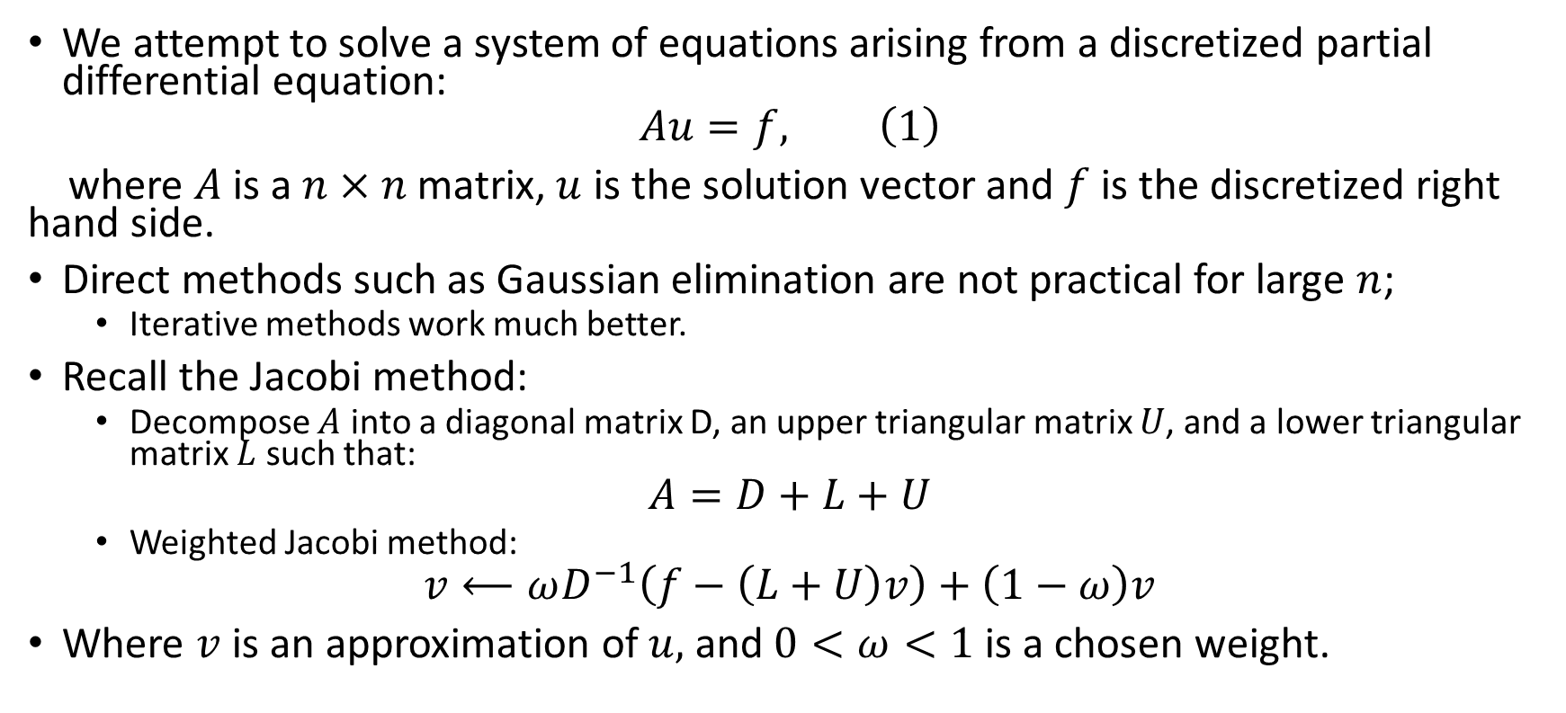
Numerically Solving PDEs
We attempt to solve a system of equations arising from a discretized partial differential equation:
$$Au=f, \left(1\right)$$
where $A$is a $n×n$matrix, $u$ is the solution vector and $f$ is the discretized right hand side.
Direct methods such as Gaussian elimination are not practical for large $n$;
Iterative methods work much better.
Recall the Jacobi method:
Decompose $A$ into a diagonal matrix D, an upper triangular matrix $U$, and a lower triangular matrix $L$ such that:
$$A=D+L+U$$
Weighted Jacobi method:
$$v⟵ωD^{−1}\left(f−\left(L+U\right)v\right)+\left(1−ω\right)v$$
Where $v$ is an approximation of $u,$ and $0<ω<1$ is a chosen weight.
Notes:
A is sparse. In large scale computing, often a matrix is in the size of thousands or millions or more. Weighted Jacobi works better, improves convergence in most cases. Iterations of the algorithm is called relaxation.

Slide 4
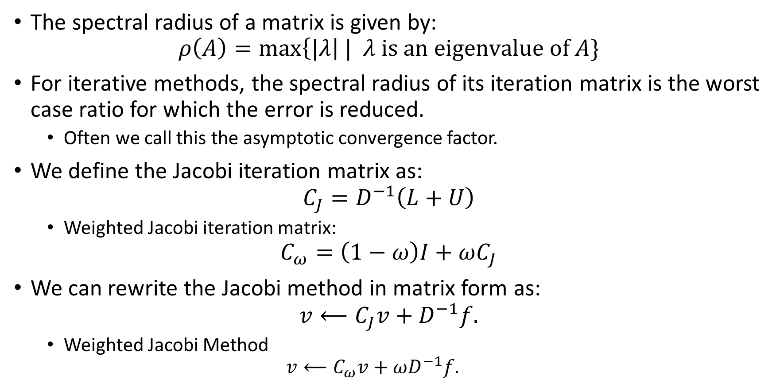
Spectral Radius
The spectral radius of a matrix is given by:
$$ρ\left(A\right)=\max\left\{|λ\right| | λ is an eigenvalue of A\}$$
For iterative methods, the spectral radius of its iteration matrix is the worst case ratio for which the error is reduced.
Often we call this the asymptotic convergence factor.
We define the Jacobi iteration matrix as:
$$C_{J}=D^{−1}\left(L+U\right)$$
Weighted Jacobi iteration matrix:
$$C_{ω}=\left(1−ω\right)I+ωC_{J}$$
We can rewrite the Jacobi method in matrix form as:
$$v⟵C_{J}v+D^{−1}f.$$
Weighted Jacobi Method
$$v⟵C_{ω}v+ωD^{−1}f.$$
Notes:
Emphasize iteration matrix (thus, the structure of A) is only factor in regards to convergence factor limit but not necessarily early error reduction.

Slide 5
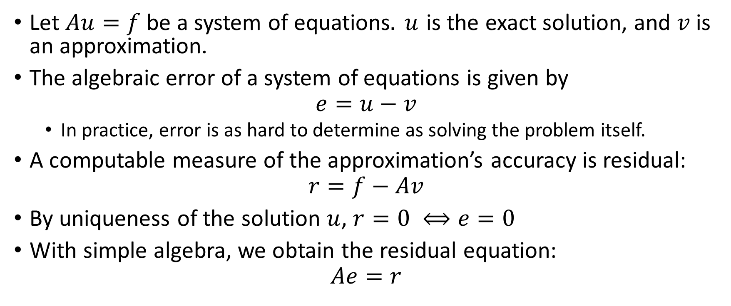
Definitions
Let $Au=f$ be a system of equations$. u$ is the exact solution, and $v$ is an approximation.
The algebraic error of a system of equations is given by
$$e=u−v$$
In practice, error is as hard to determine as solving the problem itself.
A computable measure of the approximation’s accuracy is residual:
$$r=f−Av$$
By uniqueness of the solution $u$, $r=0 ⟺e=0$
With simple algebra, we obtain the residual equation:
$$Ae=r$$
Notes:
Error vector is difference in exact solution and approximation. Remind that residual equation is important.

Slide 6
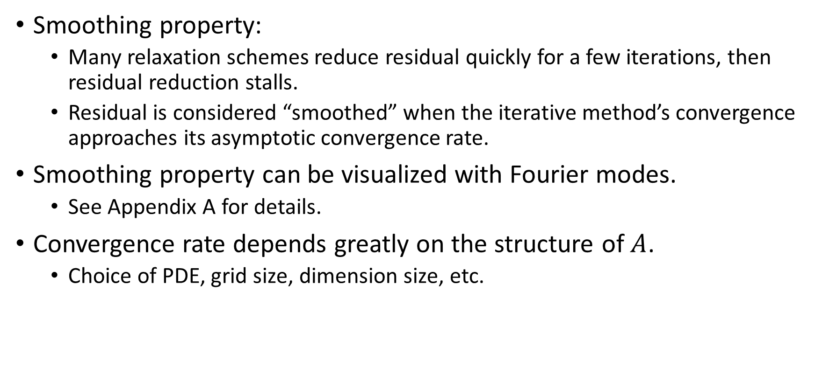
Drawbacks of Classical Iterative Methods
Smoothing property:
Many relaxation schemes reduce residual quickly for a few iterations, then residual reduction stalls.
Residual is considered “smoothed” when the iterative method’s convergence approaches its asymptotic convergence rate.
Smoothing property can be visualized with Fourier modes.
See Appendix A for details.
Convergence rate depends greatly on the structure of $A$.
Choice of PDE, grid size, dimension size, etc.
Notes:
Mention again that this means that early residual that isn’t smoothed reduces quickly. Visualization of this can be seen by using Fourier modes as our residual. Mention PDE choice, but as grid size and dimension increase, cost increases as well.

Slide 7
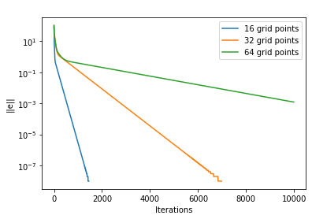
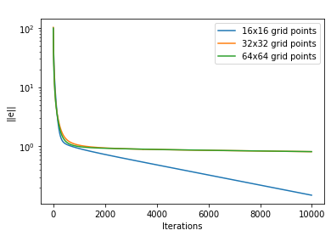
Error Reduction for
1D Poisson equation
2D Poisson equation
Notes:
By setting RHS to 0, negative residual is the error. Can see impact of increasing grid size and dimension. Error cutoff of 10e-8. X axis is iterations of relaxation scheme.

Slide 8
Table of Contents
Multigrid Methods
Traditional Iterative Methods
Geometric Multigrid (GMG)
Multilevel Neural Network Training
Introduction to ResNets
Training as a Time-Dependent PDE
Level Dependent Optimization
Numerical Results

Slide 9
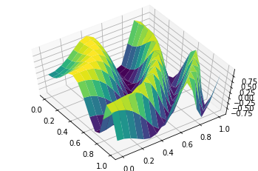
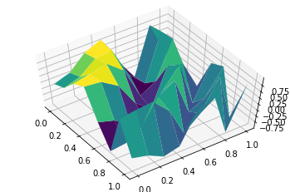
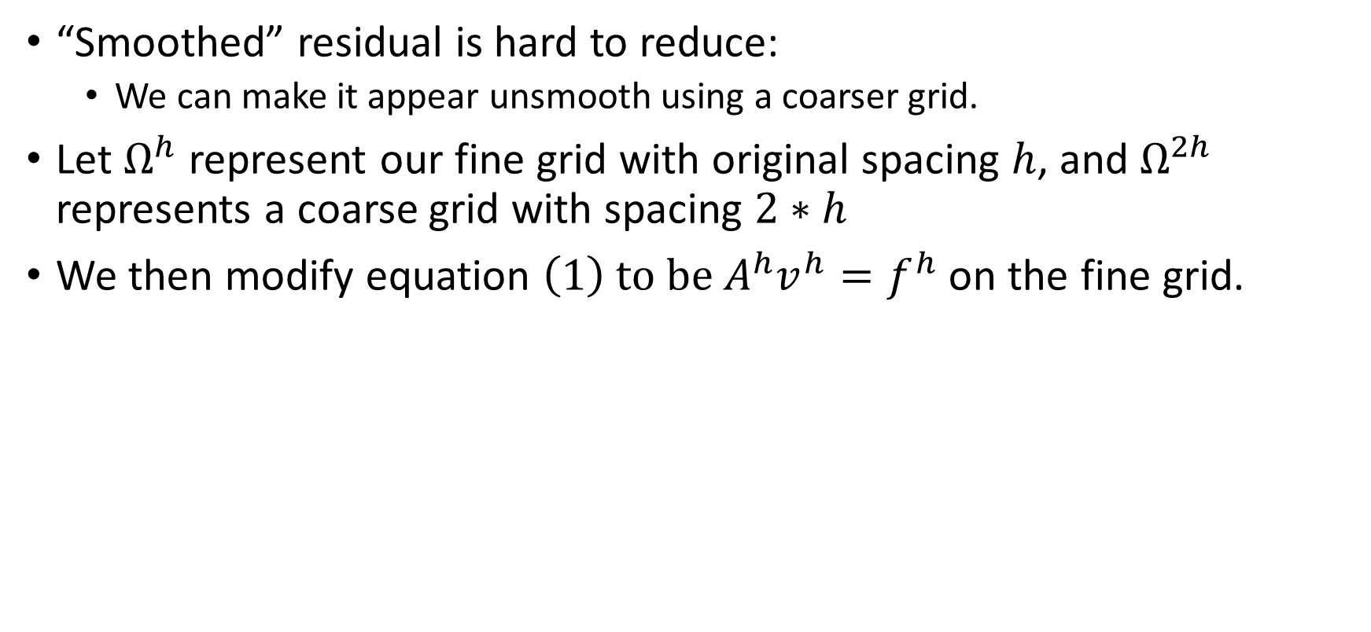
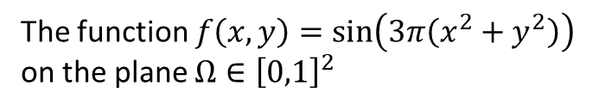
Geometric Multigrid Method (GMG)
“Smoothed” residual is hard to reduce:
We can make it appear unsmooth using a coarser grid.
Let $Ω^{h}$ represent our fine grid with original spacing $h$, and $Ω^{2h}$ represents a coarse grid with spacing $2∗h$
We then modify equation $\left(1\right) to be A^{h}v^{h}=f^{h}$ on the fine grid.
The function $f\left(x,y\right)=\sin\left(3π\left(x^{2}+y^{2}\right)\right)$ on the plane $Ω∈{\left[0,1\right]}^{2}$
16x16 grid
8x8 grid
Notes:
Mention not an exponent, but instead an indicator of the grid spacing. Oscillatory error on coarse grid will be reduced much faster. We can use the residual equation Ae=r to find an estimate of the error.

Slide 10



Interpolation and Restriction
How to move residual from fine grid to coarse grid?
How to move relaxed $e^{2h}$ from coarse grid to fine grid?
How to determine the matrix $A^{2h}$?
Restriction matrix restricts the residual from the fine grid to the coarse grid by
$$R_{h}^{2h}r^{h}=r^{2h}, R_{h}^{2h}∈ℝ^{{\left(m−1\right)}^{2}×{\left(\frac{m}{2}−1\right)}^{2}}$$
Stencil of Restriction matrix $R_{h}^{2h}$ with full weighting in 2D:
Stencil: $\frac{1}{16}\left(\begin{matrix}1 & 2 & 1 \\ 2 & 4 & 2 \\ 1 & 2 & 1\end{matrix}\right)$ Grid:
Notes:
Need a mechanic to move data from fine to coarse grids. We use the full weighting scheme. 2D version show above. Blue grid point is retained on coarse grid. Reds are not. Values represent how much weight is given for surrounding points

Slide 11
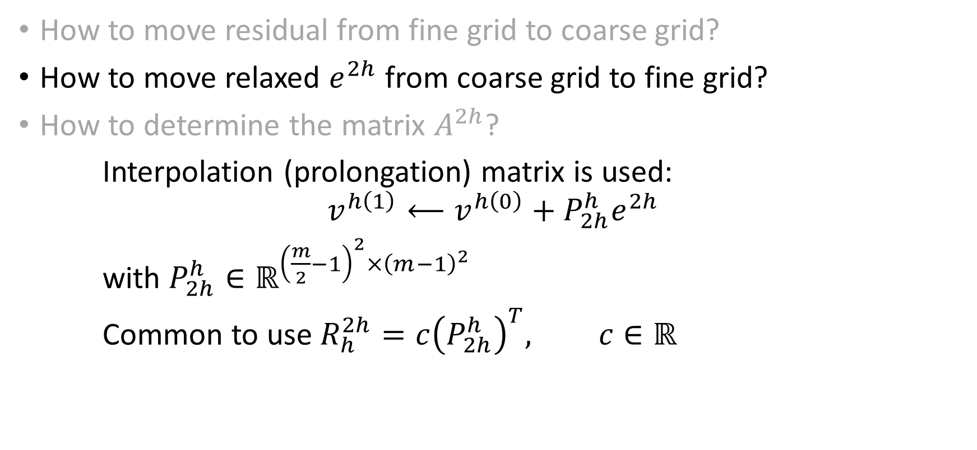
Interpolation and Restriction
How to move residual from fine grid to coarse grid?
How to move relaxed $e^{2h}$ from coarse grid to fine grid?
How to determine the matrix $A^{2h}$?
Interpolation (prolongation) matrix is used:
$$v^{h\left(1\right)}⟵v^{h\left(0\right)}+P_{2h}^{h}e^{2h}$$
with $P_{2h}^{h}∈ℝ^{{\left(\frac{m}{2}−1\right)}^{2}×{\left(m−1\right)}^{2}}$
Common to use $R_{h}^{2h}=c{\left(P_{2h}^{h}\right)}^{T}, c∈ℝ$
Notes:
Used for moving data from coarse grid to fine grid after we have relaxed on the residual equation.

Slide 12
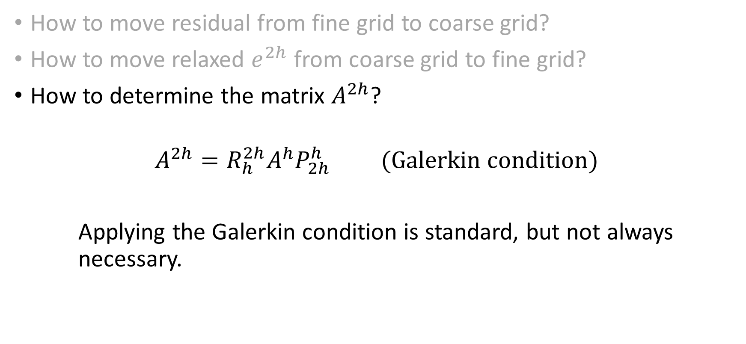
Interpolation and Restriction
How to move residual from fine grid to coarse grid?
How to move relaxed $e^{2h}$ from coarse grid to fine grid?
How to determine the matrix $A^{2h}$?
$$A^{2h}=R_{h}^{2h}{A^{h}P}_{2h}^{h} (Galerkin condition)$$
Applying the Galerkin condition is standard, but not always necessary.
Notes:
Standard, stable choice.

Slide 13
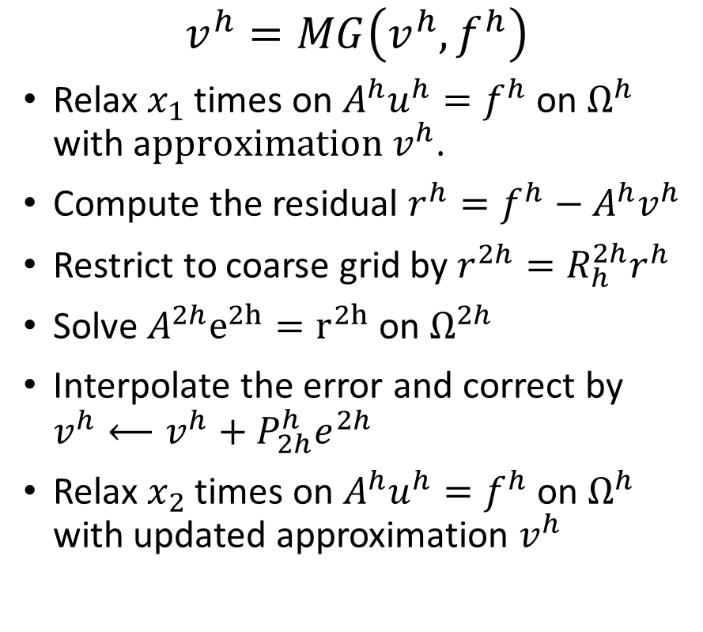
Algorithm: 2-Grid Solver
$$v^{h}=MG\left(v^{h},f^{h}\right)$$
Relax $x_{1}$ times on $A^{h}u^{h}=f^{h}$ on $Ω^{h}$ with a$pproximation v^{h}$.
Compute the residual $r^{h}=f^{h}−A^{h}v^{h}$
Restrict to coarse grid by $r^{2h}=R_{h}^{2h}r^{h}$
Solve $A^{2h}e^{2h}=r^{2h}$ on $Ω^{2h}$
Interpolate the error and correct by $v^{h}⟵v^{h}+P_{2h}^{h}e^{2h}$
Relax $x_{2}$ times on $A^{h}u^{h}=f^{h}$ on $Ω^{h}$ with updated approximation $v^{h}$
Relax on $A^{h}u^{h}=f^{h}$
Relax on $A^{h}u^{h}=f^{h}$
Restriction:
$r^{2h}=R_{h}^{2h}r^{h}$
Interpolation:
$$v^{h}⟵v^{h}+P_{2h}^{h}e^{2h}$$
Directly solve $A^{2h}e^{2h}=r^{2h}$
Notes:
Mention what relaxation is.

Slide 14
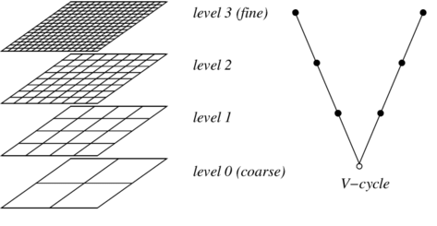
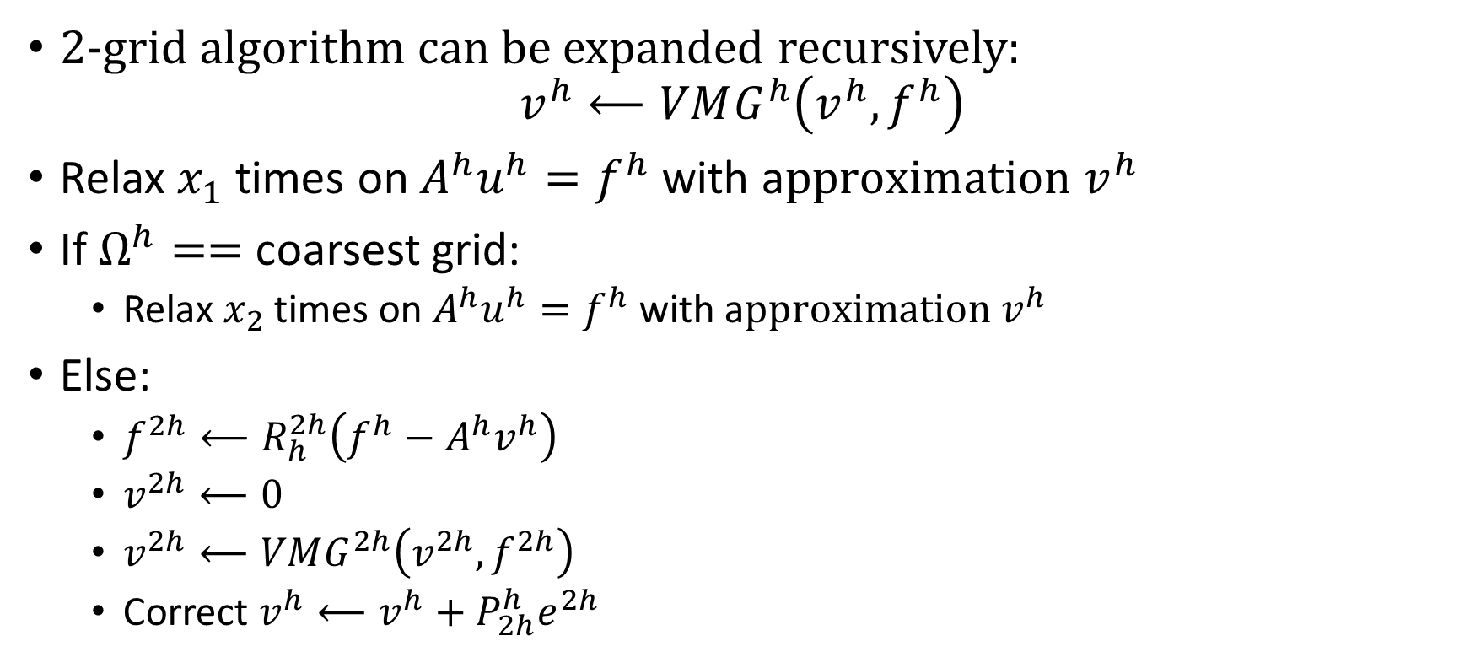
Algorithm: V-Cycle
2-grid algorithm can be expanded recursively:
$$v^{h}⟵VMG^{h}\left(v^{h},f^{h}\right)$$
Relax $x_{1}$ times on $A^{h}u^{h}=f^{h}$ with a$pproximation v^{h}$
If $Ω^{h}==$ coarsest grid:
Relax $x_{2}$ times on $A^{h}u^{h}=f^{h}$ with a$pproximation v^{h}$
Else:
$f^{2h}⟵R_{h}^{2h}\left(f^{h}−A^{h}v^{h}\right)$
$v^{2h}⟵0$
$v^{2h}⟵VMG^{2h}\left(v^{2h},f^{2h}\right)$
Correct $v^{h}⟵v^{h}+P_{2h}^{h}e^{2h}$
[P Kowalczyk et al., MIKON, 2004]
Notes:
2- grid relaxes on residual equation. 3 grid relaxes on the next residual equation with the error from grid 1 the residual. There are other cycles as well, such as W-cycle and full multigrid

Slide 15
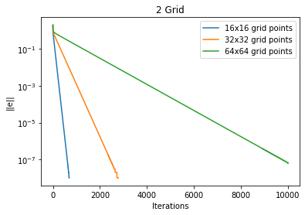
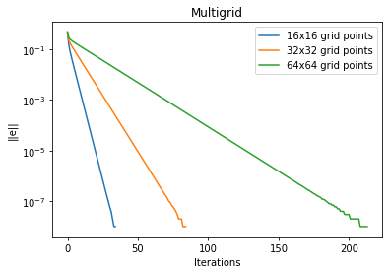
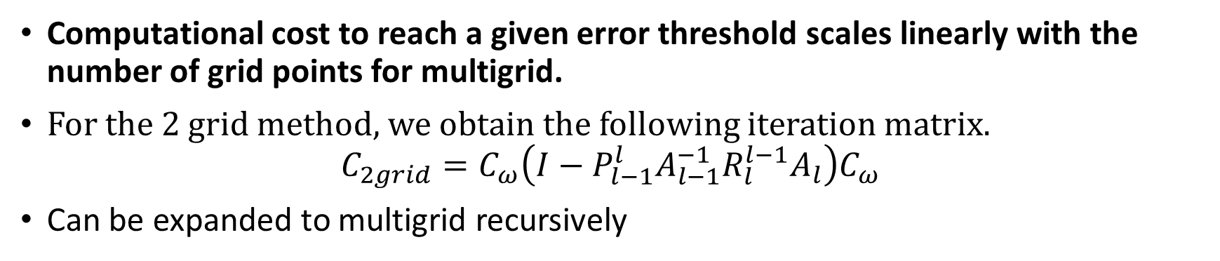
Benefits of Multigrid
Computational cost to reach a given error threshold scales linearly with the number of grid points for multigrid.
For the 2 grid method, we obtain the following iteration matrix.
$$C_{2grid}=C_{ω}\left(I−P_{l−1}^{l}A_{l−1}^{−1}{R_{l}^{l−1}A}_{l}\right)C_{ω}$$
Can be expanded to multigrid recursively
Notes:
Left uses 2 grids, right uses as many as possible (down to 2x2 grid)

Slide 16
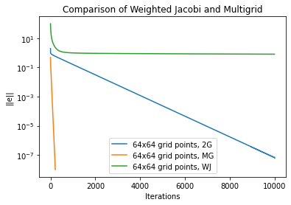
Reduction of the error norm for a 2D Poisson equation
Notes:
For 64x64 grids, MG is significantly better. Where WJ will basically never converge, and 2G takes 10s of thousands, MG takes only a couple hundred iterations.

Slide 17

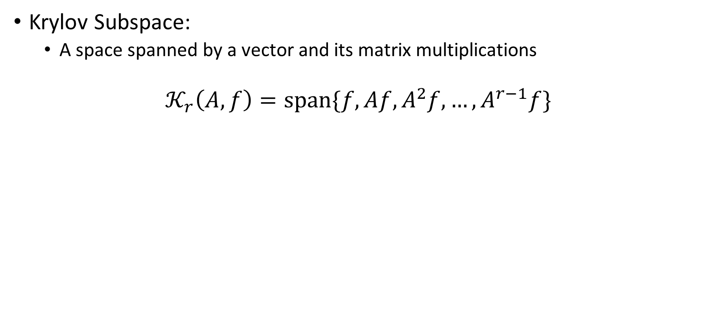


Nontraditional Iterative Methods
Krylov Subspace:
A space spanned by a vector and its matrix multiplications
$$𝒦_{r}\left(A,f\right)=span\{f,Af,A^{2}f,…,A^{r−1}f\}$$
$$Af$$
$$𝒦_{2}$$
$$f$$

Slide 18
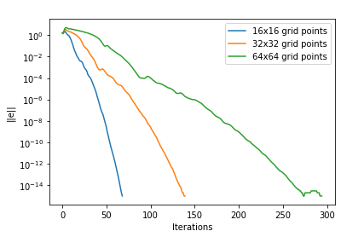

Krylov Subspace Method
Finds the best solution of a linear system in the Krylov subspace
For example, the Conjugate Gradient Method:
$f_{0}=p_{0}=f$
$x_{0}=0$
for ($k=0;k<k_{max};++k) \{$
$α_{k}≔\frac{f_{k}^{T}f_{k}}{p_{k}^{T}Ap_{k}}$
$v_{k+1}≔v_{k}+α_{k}p_{k}$
$f_{k+1}≔f_{k}−α_{k}Ap_{k}$
$β_{k}≔\frac{f_{k+1}^{T}f_{k+1}}{f_{k}^{T}f_{k}}$
$p_{k+1}≔f_{k+1}+β_{k}p_{k}$
$\}$
Notes:
First 2 lines are A-projection of the true solution on a search line, last 2 lines are A-orthoganlization of the search line.

Slide 19
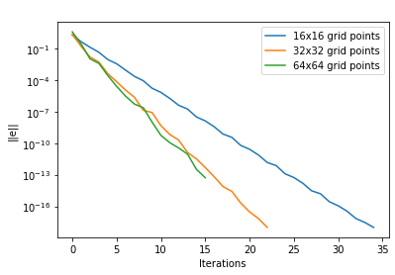

Multigrid Preconditioned CG
Preconditioned Conjugate Gradient Method:
$f_{0}=f$
$v_{0}=0$
$z_{0}=VMG\left(v_{0},f_{0}\right)$
$p_{0}=z_{0}$
for ($k=0;k<k_{max};++k)\{$
$α_{k}≔\frac{f_{k}^{T}z_{k}}{p_{k}^{T}Ap_{k}}$
$v_{k+1}≔v_{k}+α_{k}p_{k}$
$f_{k+1}≔f_{k}−α_{k}Ap_{k}$
$z_{k+1}=VMG\left(v_{k},f_{k}\right)$
$β_{k}≔\frac{f_{k+1}^{T}z_{k+1}}{f_{k}^{T}z_{k}}$
$p_{k+1}≔z_{k+1}+β_{k}p_{k}$
$\}$

Slide 20
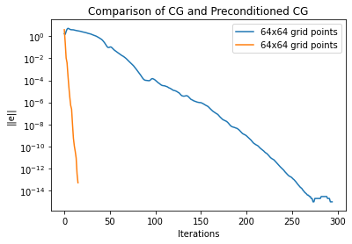

Slide 21
From Parareal to MGRIT
Goal is to solve time discretization problem iteratively rather than directly.
Parareal uses a coarse discretization to find a rough estimate, then computes directly from this estimate on a fine discretization.
Converges to same solution as a direct method slower, but parallelizable.
Easy to rewrite Parareal algorithm as a 2-grid method.
Coarse discretization is related to a coarse grid:
Residual (difference between coarse and fine approximations) is used to improve fine approximations.
MGRIT expands parareal from a 2-grid method to a full V cycle.

Slide 22
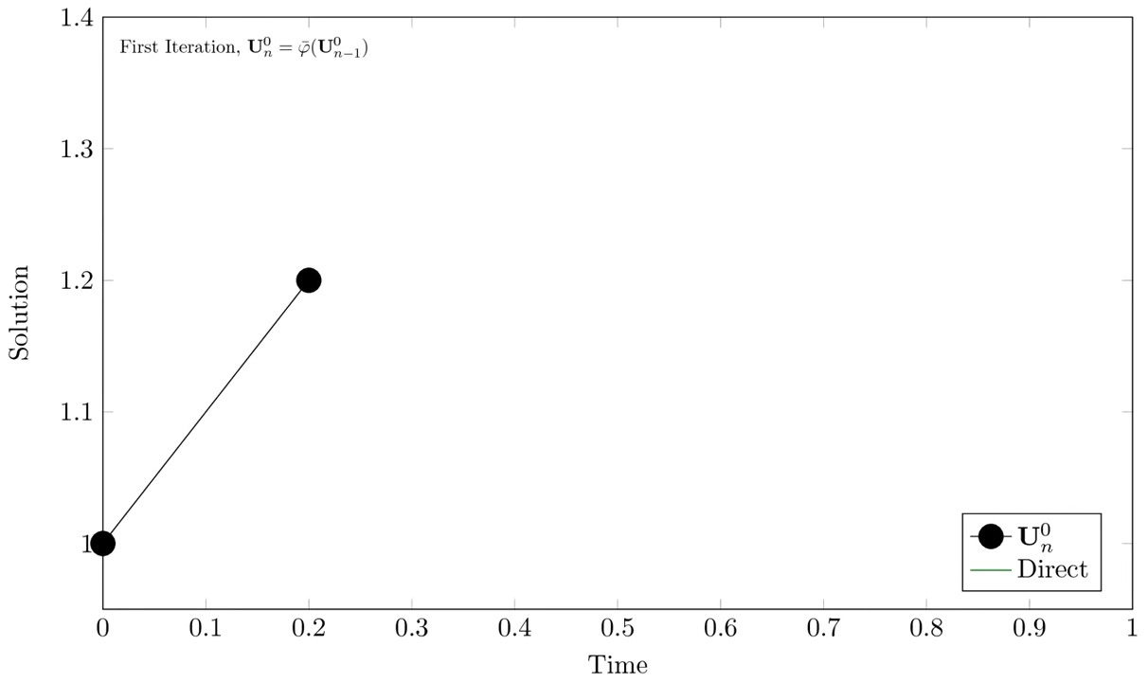
Parareal as a 2-Grid

Slide 23
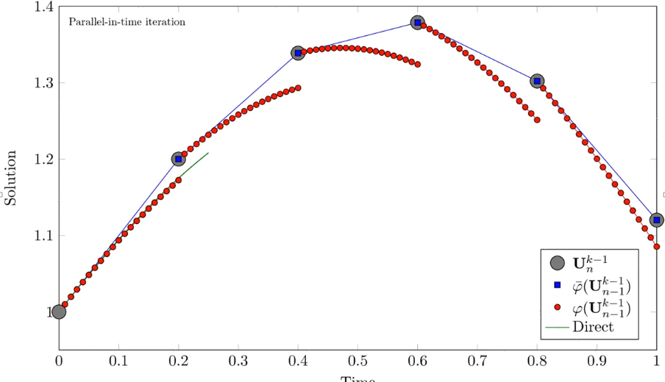
Red Dots are fine grid points
Intervals are the residuals; values of the coarse grid.

Slide 24
What now?
Interested readers can read the original MGRIT paper:
Read sections:
1. Introduction
2. Time integration methods
3. Multigrid in time algorithm
Don’t get caught up on the math in 3.1!
Otherwise, work on rewriting knowledge-based model with:
Parareal and pyMP
pyMGRIT
Save all 3 models for benchmarking!
Try with different time steps, grid sizes (number of processors)
Colab only allows 2 processors: for more, use your personal computer (probably 4-8)
Send me your code: I can run it on a Utokyo supercomputer for up to 112 processors (can’t do more as its not my work!)

Slide 25
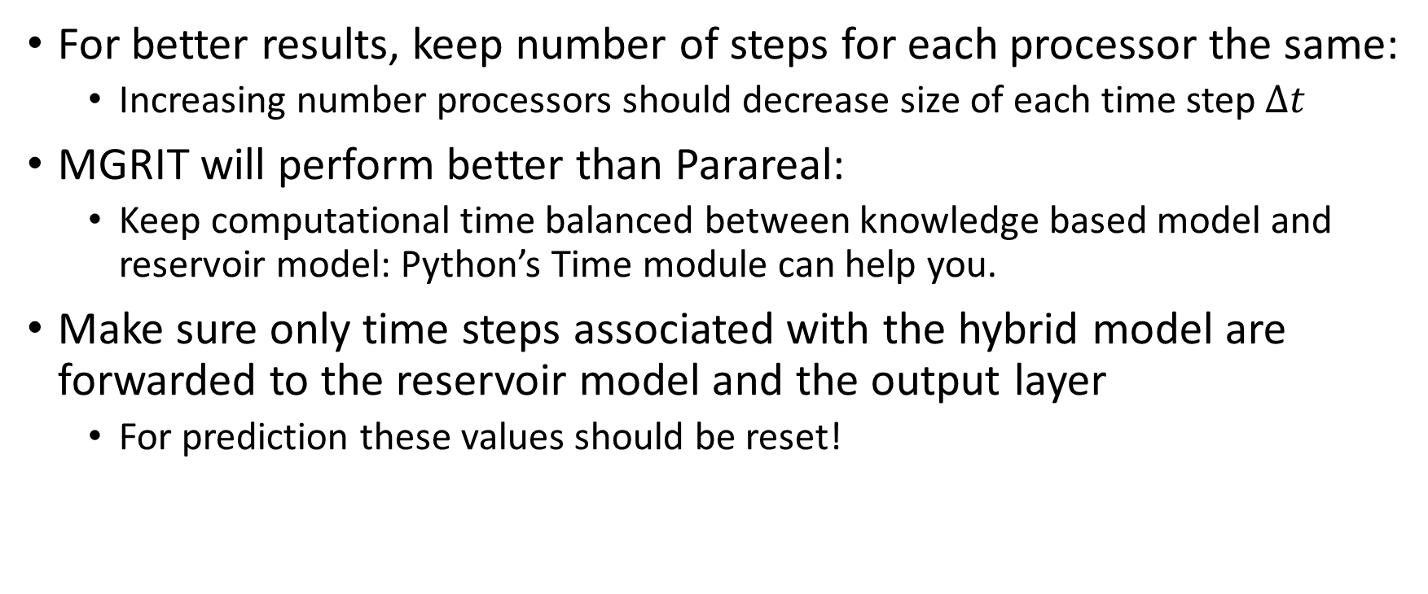
Hints:
For better results, keep number of steps for each processor the same:
Increasing number processors should decrease size of each time step $Δt$
MGRIT will perform better than Parareal:
Keep computational time balanced between knowledge based model and reservoir model: Python’s Time module can help you.
Make sure only time steps associated with the hybrid model are forwarded to the reservoir model and the output layer
For prediction these values should be reset!

